Slide 1

Welcome to the
FIP PS Commission Conference and Qualifying Seminar
MACAO 2026
The Postal Stationery Commission
https://postalstationery.f-i-p.ch/

Slide 2
Agenda
Registration of Delegates
Welcome and Report from the Chairman (Ian McMahon)
Election of the Bureau (Reinaldo Macedo)
Postal Stationery Qualifying Seminar
  Judging Postal Stationery (Mike Smith)
  Treatment (Sam Chiu)

Slide 3
Agenda
Registration of Delegates
Welcome and Report from the Chairman (Ian McMahon)
Election of the Bureau (Reinaldo Macedo)
Postal Stationery Qualifying Seminar
  Judging Postal Stationery (Mike Smith)
  Treatment (Sam Chiu)

Slide 4
Postal Stationery Commission Bureau
Update
The Postal Stationery Commission
Presented
On behalf of the Postal Stationery Commission
Dr Ian McMahon
FAP, FRPSV, FRPSL, FIP Jury Fellow
FIP PS Commission Chairman
https://postalstationery.f-i-p.ch/

Slide 5
The Postal Stationery Commission
The Purpose of the Commission:
To develop and promote interest in Postal Stationery
To establish rules and procedures in Postal Stationery exhibiting
Members of the Commission:
One representative from each FIP member
The Commission Bureau consist of a Chairman, a Secretary, three continental representatives and two appointed members
https://postalstationery.f-i-p.ch/

Slide 6
PS Commission Bureau
The Commission Bureau 2022-2026 is:
Chairman: Ian McMahon, Australia
Secretary: Michael Smith, UK
FIAP Representative: Frank Li Zhifei, China
FEPA Representative: Igor Pirc, Slovenia
FIAF Representative & Webmaster: Ross Towle, USA
Appointed by the Chairman: Juan Reinoso, Costa Rica
Appointed by the Chairman: Sammy Chiu, Canada

Slide 7
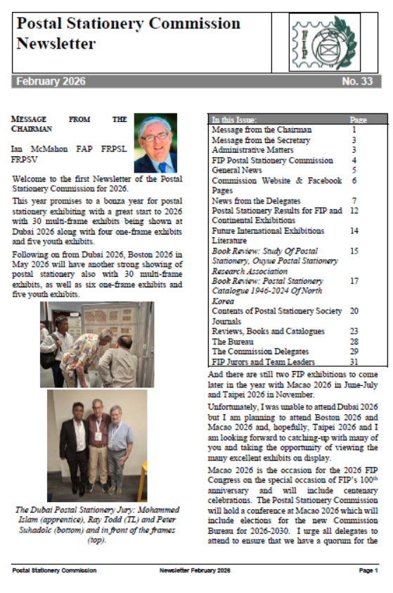
February 2026 Newsletter
Message from the Chairman
Message from the Secretary
FIP Postal Stationery Commission
General News and Administrative Matters
Commission Website & Facebook Pages
News from Delegates
Postal Stationery Results for FIP/Continental Exhibitions
Future International Exhibitions
Book Reviews: Study Of Postal Stationery,
Ouyue Postal Stationery Research Association;
Postal Stationery Catalogue 1946-2024 Of North Korea
Literature; Contents of Postal Stationery Society Journals
Reviews, Books and Catalogues
The Bureau
The Commission Delegates
FIP Jurors and Team Leaders
Copies available to all – email secretary Mike Smith mikesmith.philatelist@gmail.com

Slide 8
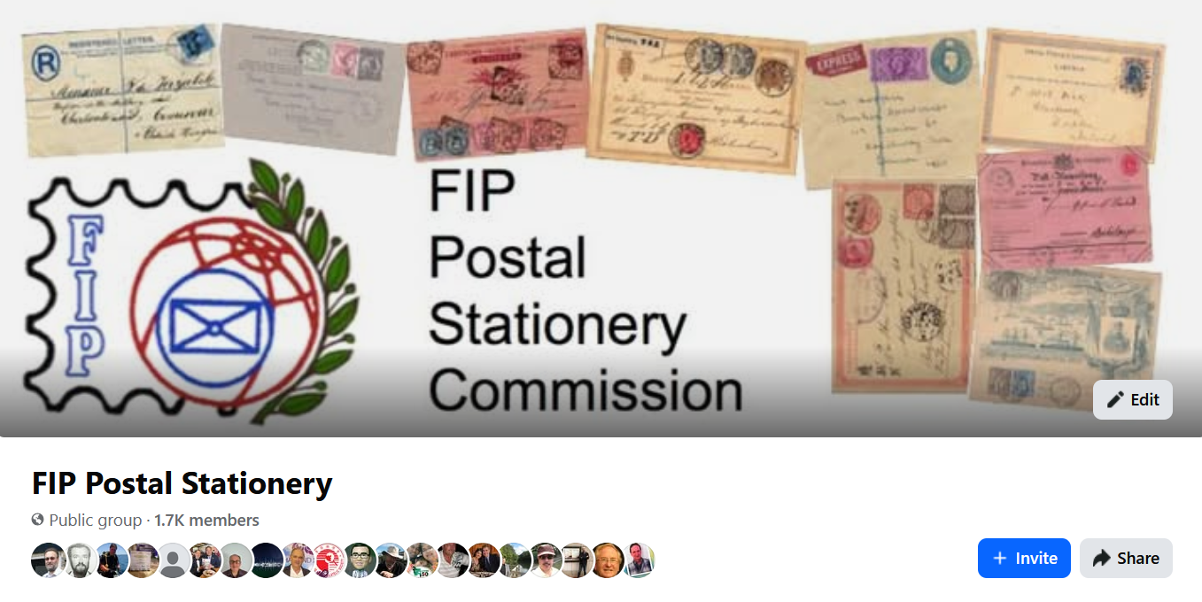
Commission Facebook Page
Please follow the page and make posts on any postal stationery topic.

Slide 9

Commission Webpage: https://postalstationery.f-i-p.ch/
Commission website hosted by FIP
Webmaster: Ross Towle
Updated with news on exhibiting and judging postal stationery
Please use the site

Slide 10
Postal Stationery Exhibits
PS exhibits in recent FIP international exhibitions
Uruguay 2025 (FIP) 17 exhibits; 1 Large Gold, 9 Gold, 5 Large Vermeil
Europhilex 2025 (FEPA) 24 exhibits; 1 Large Gold, 9 Gold, 8 Large Vermeil
PHILAKOREA 2025 (FIP) 16 exhibits (+ 2 One-frame and 2 Youth): 2 Large Gold, 3 Gold, 7 Large Vermeil
DUBAI 2026 (FIP) 26 exhibits (+ 4 One-frame and 5 Youth); 2 Large Gold, 7 Gold, 10 Large Vermeil

Slide 11
International Exhibitions with a Postal Stationery Class
26 June - 1 July 2026 | Macao SAR China | MACAO 2026 | FIP + Congress | https://www.macao2026.org.mo/
27th to 31st August 2026 | Indonesia, Bandung | Bandung 2026 | FIAP | https://bandung2026fiap.com/
20 - 25 Nov 2026 | Chinese Taipei, Taipei | PHILATAIPEI 2026 | FIP | https://taipei2026.post.gov.tw › taipei2026
12-17 October 2027 TBC | Serbia, Belgrade | Belgrade 2027 | FIP | http://www.belgrade2027.org/
22-26 March 2028 | Czech Republic, Prague | PRAGA 2028 EXPO | FIP | http://www.praga2028.cz/
26-29 October 2028 | Germany, Ulm | IBRA 2028 | FIP | https://www.ibra2028.com/

Slide 12
FIP POSTAL STATIONERY COMMISSION: PROJECTS 2022-2026
Project | Responsible
Project 1: Newsletters We will continue to issue our commission newsletter with information on exhibition results, articles on exhibiting etc. The Newsletter will be issued twice a year | Mike Smith, Ian McMahon | Newsletters were published in each August and February
Project 2: Review of the Postal Stationery SREVs Review the SREVs to ensure that they align with the guidelines of the other classes (eg in the description of judging criteria) following the 2022 revisions of the guidelines. Examine the definitions of Postal Stationery to ensure that they are clear noting the Study by the FIAF Postal Stationery Commission and other comments. | Ian McMahon and Mike Smith | The Bureau reviewed the current Postal Stationery Rules and Guidelines to determine whether any changes are required. The Bureau agreed that no significant changes were necessary and that no revision of the “SREVs and Guidelines” was currently required.
Project 3: Commission Website Update Further Development and Updating of the commission website | Ross Towle Content: All members | Website was updated with a new postal-stationery related banner and with new content including newsletters, presentations and postal stationery exhibition results.

Slide 13
Project 4: Seminars & New Presentations We will develop a new version of the general presentation on judging postal stationery. |  | Seminar updated for each qualifying seminar. Sam Chiu prepared a comphrehensive presentation on ’Teatment of Postal Stationery’ whcih has been incorporated into the qualifying seminar.
Project 5: On-Line Dissemination of Seminars and Presentations Commission Presentations can be held by Zoom with the presentations recorded. Links to recorded presentations placed on the Commission website with the videos stored on YouTube. |  | Qualifying seminars EFIRO 2024; Uruguay 2025; PHILAKOREA 2025 Presentations available on the Commission website. Uruguay 2025 presentation on the Federación Uruguaya de Filatelia’s YouTube channel.
Project 6: Commission Facebook page We will make a Facebook page for the commission and open up for dialogue between exhibitors, jurors and the commission | Ian McMahon & Mike Smith | Facebook page updated. Used for anouncements of seminars and other Commission activities as well as for discussion of postal stationery topics

Slide 14

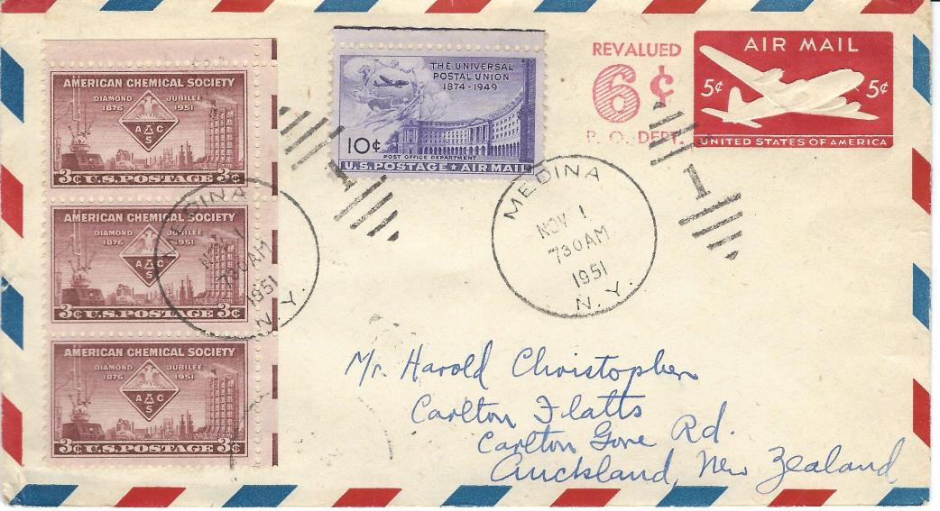
Questions?

Slide 15
Agenda
Registration of Delegates
Welcome and Report from the Chairman (Ian McMahon)
Election of the Bureau (Reinaldo Macedo)
Postal Stationery Qualifying Seminar
  Judging Postal Stationery (Mike Smith)
  Treatment (Sam Chiu)

Slide 16
Postal Stationery Commission Bureau
Elections
Reinaldo Macedo
FIP Board Member responsible for the PS Commission
The Postal Stationery Commission

Slide 17
The Following Nominations have been received for Bureau positions on the Commission:
POSTAL STATIONERY
Position | Nominations 2026 - 2030
Chairman | SMITH Mike, UK
Secretary | CHIU Sam, Canada
Europe Bureau Member | PIRC Igor, Slovenia
Americas Bureau Member | No Nomination
Asia Bureau Member | CHIVERS Stephen, NZ

Slide 18
Agenda
Registration of Delegates
Welcome and Report from the Chairman (Ian McMahon)
Election of the Bureau (Reinaldo Macedo)
Postal Stationery Qualifying Seminar
  Judging Postal Stationery (Mike Smith)
  Treatment (Sam Chiu)

Slide 19
Qualifying Seminar
Judging Postal Stationery
The Postal Stationery Commission
Presented
On behalf of the Postal Stationery Commission
Mike Smith
FRPSL, FIP Jury Fellow
FIP PS Commission Secretary
https://postalstationery.f-i-p.ch/

Slide 20
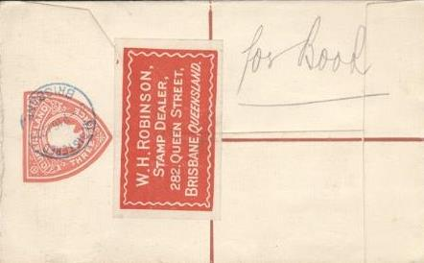
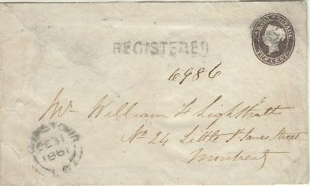

The Definition of Postal Stationery
“Postal Stationery comprises postal matter which either bears an officially authorized
pre-printed stamp or device or inscription indicating that a specific face value of postage or related service has been prepaid”
Defined by FIP Postal Stationery Commission in the regulations for judging postal stationery exhibits

Slide 21
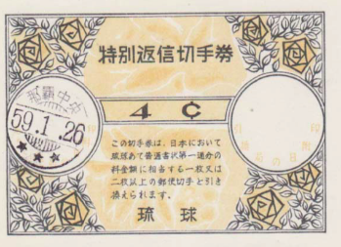
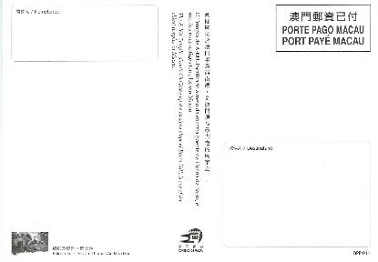
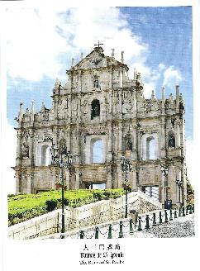

Material which can be included
1.3.2 Non value indicators. More recently a growing number of Postal Administrations have introduced postal stationery which, while sold to the public at a specific price, merely indicates that a particular service/postage rate has been prepaid without indication of value - termed "non value indicators" (NVI). Such material is of course appropriately included in exhibits of postal stationery. 1.3.3 Telegraph Forms can be exhibited as postal stationery. 1.3.4 Money Orders/Postal Orders/Postal Notes can be exhibited as either postal stationery or revenues. 1.3.5 International Reply Coupons have traditionally been accepted as part of postal stationery and can be exhibited in this class
“Non value indicators" (NVI) postal stationery: indicates that a particular service/postage rate has been prepaid without indication of value
Stamped Telegraph Forms
Stamped Money Orders /Postal Orders/ Postal Notes
International Reply Coupons
“Formular" items which were sold to the public bearing adhesive stamps, as fore-runners to the issue of postal stationery items with impressed stamps.

Slide 22

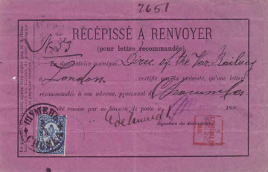
Material which cannot be included
unstamped stationery ‘formular’ items
unstamped stationery post office forms
unstamped military stationery
unstamped postal administration stationery
official franks
meter post impressions
privately generated 'Postage Paid Impressions’

Slide 23



Essays, Proofs, Archival Material welcomed
Archival material: Essays, proofs and specimens can be included in postal stationery exhibits
Should be properly described
Care to ensure items related to postal stationery

Slide 24

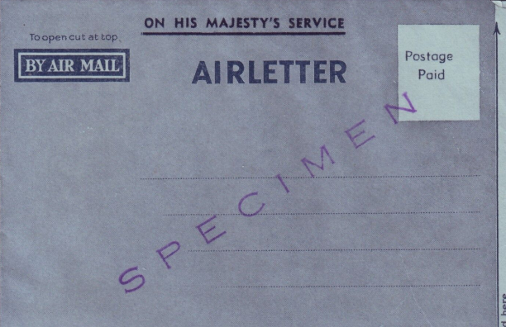
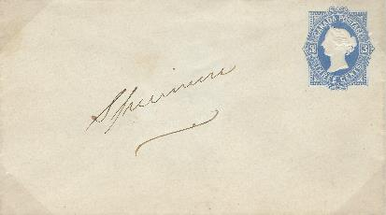
Specimens
UPU Specimens
Printer’s specimens
Post Office specimens – displays, presentation, for collectors
Should be properly described
For some small British Colonies UPU Specimen stationery can be more common than used

Slide 25


The Use of Cut-Outs in Exhibits
Usually postal stationery exhibits consist of whole items. If entires of a specific type only exists as a cut-out or is very rare in whole form, then cut-outs can be part of the exhibit
In some countries cut-outs could be used as adhesive stamps. Cut-outs used in this way on entires can also be part of a postal stationery exhibit

Slide 26
Organisation of a Postal Stationery Exhibit
The Physical Form
The Availability
The Function
This is important when defining the scope of the postal stationery exhibit

Slide 27
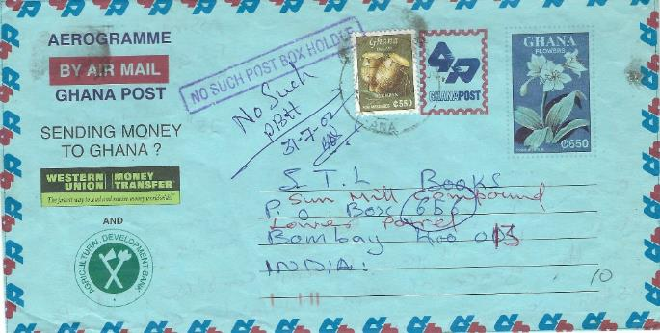


Postal Stationery: The Physical Form
Letter Sheets & Aerogrammes
Envelopes & Registered Envelopes
Postal Cards & Reply Cards
Letter Cards
Wrappers
Printed Forms

Slide 28
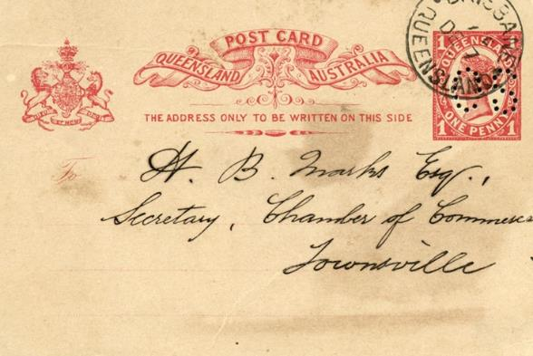

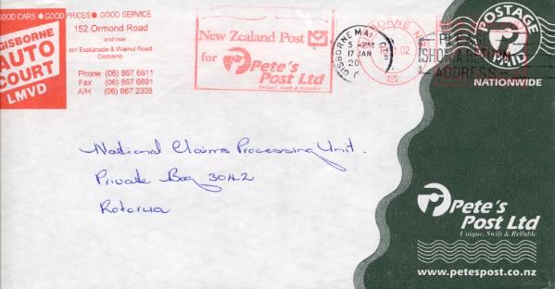
Postal Stationery:
The Availability
Post Office Issues (for public use)
Military Issues (for members of the armed forces)
Official Service (for use of government)
Local Post (for public use locally)
Stamped to Order (ordered by private individuals or organizations)

Slide 29


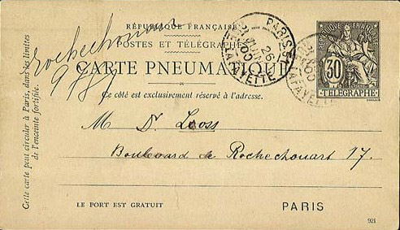
Postal Stationery:
The Function
Postal (surface): Local, inland or foreign
Airmail: Inland or foreign
Registered: Inland or foreign
Telegraph: Inland or foreign
Parcel Cards
Money Orders
Etc.

Slide 30

Regulations
Both exhibitors and jurors MUST read the regulations and guidelines
The postal stationery guidelines were last updated in 2013.
http://www.f-i-p.ch/wp-content/uploads/Postal-Stationery.pdf

Slide 31
Judging of Postal Stationery
The Postal Stationery Class evolved from the Traditional Philately Class, NOT the Postal History Class
It was originally a subset of the Traditional Class
The judging criteria are the same as the Traditional Class
The Focus of an exhibit should be on the Traditional aspects, NOT the Postal History aspects
Unfortunately the current trend amongst exhibitors is to concentrate on the Postal History aspects!

Slide 32
The Judging Criteria
Treatment (20)
and philatelic importance (10) 30 points
Philatelic and related knowledge,
personal study and research 35 points
Condition (10)
and rarity (20) 30 points
Presentation: 5 points

Slide 33
Treatment (20 points)
Primary Focus should be “Traditional”
Construct an exhibit on “Traditional” lines
Select a Scope for the exhibit that allows a thorough “Traditional Treatment”
Secondary Treatment should include Examination of the Postal History elements
  Rates are most important
  Routes are less important
  Markings (Marcophily) is the least important
Notes:
Primary Treatment should be Traditional
Main page headings must reflect this
The story line must be about the stationery items themselves
Construct an exhibit on traditional lines
For each issue
Archival Material
Unused
Used
Select a Scope for the exhibit that allows a thorough Traditional Treatment
Shorter Period allows more comprehensive Traditional Treatment

Slide 34
Scope
Stationery items are larger than stamps!
The number of items that can be shown in the same space is therefore significantly lower
The implication of this is that the “breadth” or “depth” are reduced relative to “stamp exhibits”
  Currently, most PS exhibits concentrate on “breadth” rather than “depth” which means the philatelic study is usually very limited/superficial
  Would be better to study a shorter period in greater depth to demonstrate “philatelic knowledge”
Notes:
Stationery items are larger than stamps!
The number of items that can be shown in the same space is significantly lower (stamps with “large margins”)
The implication of this is that the breadth or depth are reduced relative to a stamp exhibit
Most PS exhibits concentrate on “breadth” rather than “depth” which means the philatelic study is usually very limited/superficial
Would be better to study a shorter period in greater depth to demonstrate “philatelic knowledge”

Slide 35
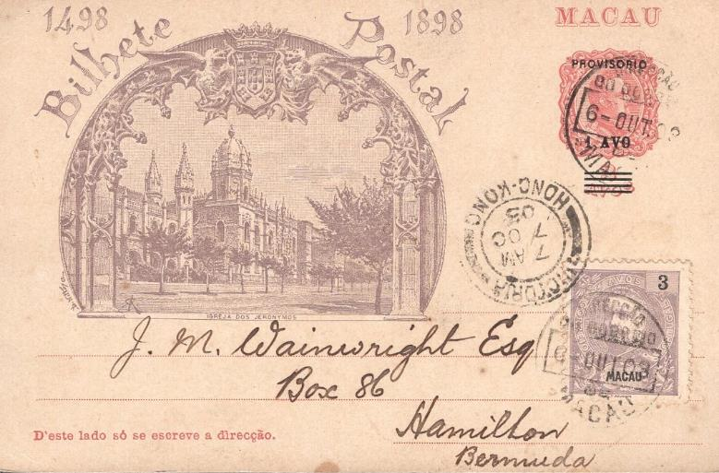
Treatment
The subject of Sam’s presentation later in this seminar, so I won’t say anymore!

Slide 36
Philatelic Importance (10 points)
How difficult is the selected area?
What is the significance of the selected area compared to the national philately of the country?
What is the significance of the selected area compated to world philately?
What is the significance of the shown material compared to the selected area?

Slide 37
Knowledge, Personal Study and Research (35 points)
Key Traditional Information is often missing from exhibits
  Many exhibitors only provide very basic information, such as that provided by H&G and little more!
  You need to say more than what is obvious from the item itself e.g. value and colour
Need to go well beyond standard catalogues and demonstrate a good understanding of printing techniques and showcase your new research!

Slide 38
Knowledge, Personal Study and Research
Correct description of the postal stationery type
Use of literature within the area
Earliest recorded use & numbers printed
Watermarks, perforations, paper etc described
Description of printings and varieties
Research (lack of research in areas previously well-described is ok)
Correct descriptions of rates and usage
The ”not-obvious” is described
The choice of items also reflects knowledge

Slide 39
Material Selection
Need to show early usages - often these are lacking for earlier issues
  E.g. First issue was 1d card in 1880 for internal use, first shown is from 1895 to Germany when 1d was UPU rate
Need to show the intended use - this is more important than uprated examples
  For “long lived” issues, the intended use can change over time!
Sometimes you have to leave out very good items
  Don’t force them in, just because they are good!
Every item should be there for a reason
  That reason should not be just filling space!
Showing multiple example of the same card, showing the same rate is duplication and should be avoided

Slide 40
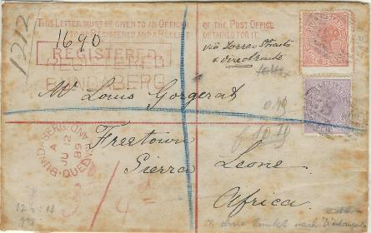
Condition (10 points)
The postal stationery is in the best possible quality
Ordinary material without defects
”Difficult” items in the best possible quality
Clear postmarks
Evaluate the condition of the items as if they were stamps:
No tears, No missing corners, No bends, No stains, No missing perforation

Slide 41
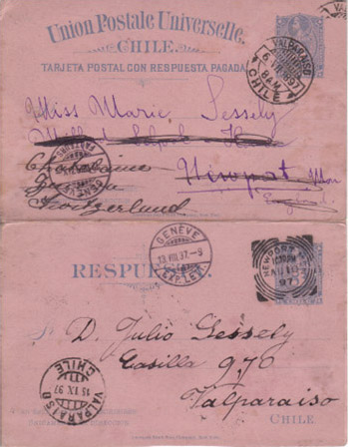
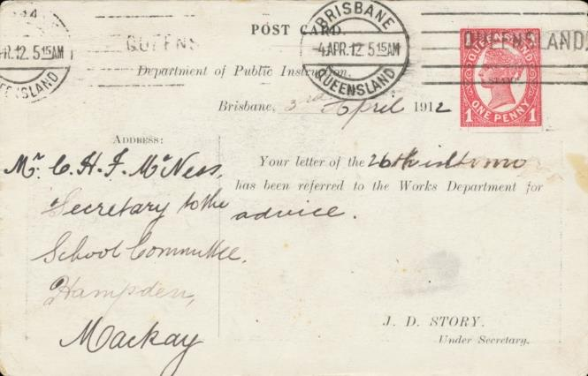
Rarity (20 points)
Are the best items (postal stationery types) within the area in this exhibit?
Essays and proofs, approved and rejected
Used at intended rate and with additional franking (express, registered etc)
How difficult are the items to find?
How easy will it be to duplicate the exhibit?
Is there philatelic produced material in the exhibit?
Correctly used international reply cards
Exhibitor should identify rare items (eg right) Queensland 1d Official Postcard less than 5 known

Slide 42
Rarity and Desirability
Most postal stationery items have very small print runs compared to stamps
Desirability should be reflected in Importance not rarity - rarity is rarity i.e. absolute
However, more desirable items are more likely to have been recorded, so the numbers are likely to be a truer reflection of absolute rarity

Slide 43
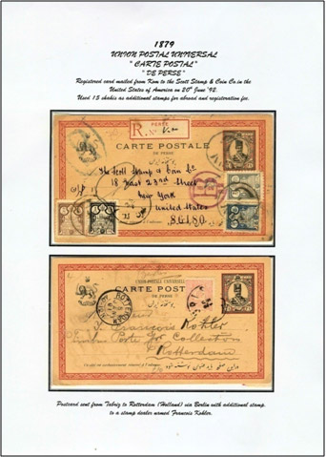
Presentation (5 points)
Good balance in the frames and the individual pages
Sufficient write up
Not too much text; Illustrations not too dominating
Overall impression: Not sloppy
Variation in mounting is preferred
Presentation is critical, if this is poor then:
  The treatment won’t come through and won’t be appreciated!
  The best items will be missed!
  New research will be hidden away!

Slide 44

Write Up
Minimalist approach to the write up
  Use diagrams and illustrations - a picture is worth a thousand words
  Write the text then review and precis it down to the minimum without losing the message
The material must be the dominant thing on each page
  You must not distract the viewer from it!

Slide 45







Variation in Mounting
It is easy to make variation in the mounting

Slide 46
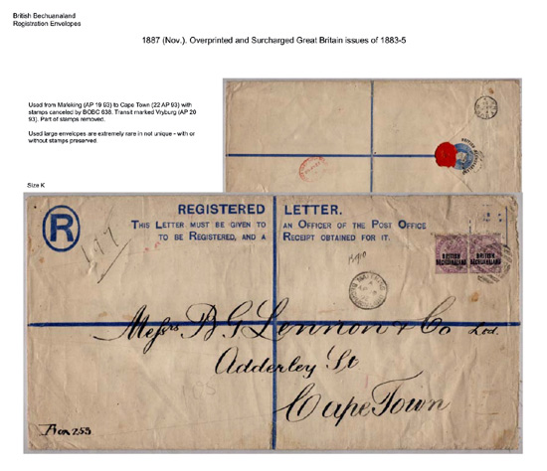
Mounting Large Items
Mounting large items can be a challenge
Especially registered covers and wrappers can be oversized
(Size K envelope)

Slide 47
”White Space”
Unlike some classes, “White Space” doesn’t have to be filled!
  Please let your exhibit “breathe”
  Can help lead the judge to better items!
However, excessive amounts of “White Space” will lead the jury to assume that the exhibitor has insufficient material to fill the allocated space!

Slide 48
Some Good News!
Postal Stationery is now taken much more seriously by both judges and exhibitors?
25 Years ago a International Large Gold in PS was almost impossible!
An International Large Gold is now possible with many PS subjects?

Slide 49
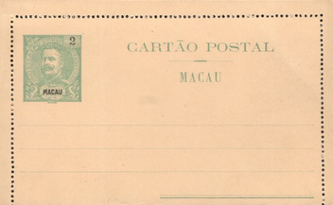
Questions?

Slide 50
Judging of Postal Stationery
The Postal Stationery Class evolved from the Traditional Philately Class, NOT the Postal History Class
It was originally a subset of the Traditional Class
The judging criteria are the same as the Traditional Class
The Focus of an exhibit should be on the Traditional aspects, NOT the Postal History aspects
Unfortunately the current trend amongst exhibitors is to concentrate on the Postal History aspects!

Slide 51
The Judging Criteria
Treatment (20)
and philatelic importance (10) 30 points
Philatelic and related knowledge,
personal study and research 35 points
Condition (10)
and rarity (20) 30 points
Presentation: 5 points

Slide 52
Treatment (20 points)
Primary Focus should be “Traditional”
Construct an exhibit on “Traditional” lines
Select a Scope for the exhibit that allows a thorough “Traditional Treatment”
Secondary Treatment should include Examination of the Postal History elements
  Rates are most important
  Routes are less important
  Markings (Marcophily) is the least important
Notes:
Primary Treatment should be Traditional
Main page headings must reflect this
The story line must be about the stationery items themselves
Construct an exhibit on traditional lines
For each issue
Archival Material
Unused
Used
Select a Scope for the exhibit that allows a thorough Traditional Treatment
Shorter Period allows more comprehensive Traditional Treatment

Slide 53
Scope
Stationery items are larger than stamps!
The number of items that can be shown in the same space is therefore significantly lower
The implication of this is that the “breadth” or “depth” are reduced relative to “stamp exhibits”
  Currently, most PS exhibits concentrate on “breadth” rather than “depth” which means the philatelic study is usually very limited/superficial
  Would be better to study a shorter period in greater depth to demonstrate “philatelic knowledge”
Notes:
Stationery items are larger than stamps!
The number of items that can be shown in the same space is significantly lower (stamps with “large margins”)
The implication of this is that the breadth or depth are reduced relative to a stamp exhibit
Most PS exhibits concentrate on “breadth” rather than “depth” which means the philatelic study is usually very limited/superficial
Would be better to study a shorter period in greater depth to demonstrate “philatelic knowledge”

Slide 54
Treatment
The subject of Sam’s presentation later in this seminar, so I won’t say anymore!

Slide 55
Philatelic Importance (10 points)
How difficult is the selected area?
What is the significance of the selected area compared to the national philately of the country?
What is the significance of the selected area compated to world philately?
What is the significance of the shown material compared to the selected area?

Slide 56
Knowledge, Personal Study and Research (35 points)
Key Traditional Information is often missing from exhibits
  Many exhibitors only provide very basic information, such as that provided by H&G and little more!
  You need to say more than what is obvious from the item itself e.g. value and colour
Need to go well beyond standard catalogues and demonstrate a good understanding of printing techniques and showcase your new research!

Slide 57
Knowledge, Personal Study and Research
Correct description of the postal stationery type
Use of literature within the area
Earliest recorded use & numbers printed
Watermarks, perforations, paper etc described
Description of printings and varieties
Research (lack of research in areas previously well-described is ok)
Correct descriptions of rates and usage
The ”not-obvious” is described
The choice of items also reflects knowledge

Slide 58
Material Selection
Need to show early usages - often these are lacking for earlier issues
  E.g. First issue was 1d card in 1880 for internal use, first shown is from 1895 to Germany when 1d was UPU rate
Need to show the intended use - this is more important than uprated examples
  For “long lived” issues, the intended use can change over time!
Sometimes you have to leave out very good items
  Don’t force them in, just because they are good!
Every item should be there for a reason
  That reason should not be just filling space!
Showing multiple example of the same card, showing the same rate is duplication and should be avoided

Slide 59
Condition (10 points)
The postal stationery is in the best possible quality
Ordinary material without defects
”Difficult” items in the best possible quality
Clear postmarks
Evaluate the condition of the items as if they were stamps:
No tears, No missing corners, No bends, No stains, No missing perforation

Slide 60
Rarity (20 points)
Are the best items (postal stationery types) within the area in this exhibit?
Essays and proofs, approved and rejected
Used at intended rate and with additional franking (express, registered etc)
How difficult are the items to find?
How easy will it be to duplicate the exhibit?
Is there philatelic produced material in the exhibit?
Correctly used international reply cards
Exhibitor should identify rare items (eg right) Queensland 1d Official Postcard less than 5 known

Slide 61
Rarity and Desirability
Most postal stationery items have very small print runs compared to stamps
Desirability should be reflected in Importance not rarity - rarity is rarity i.e. absolute
However, more desirable items are more likely to have been recorded, so the numbers are likely to be a truer reflection of absolute rarity

Slide 62
Presentation (5 points)
Good balance in the frames and the individual pages
Sufficient write up
Not too much text; Illustrations not too dominating
Overall impression: Not sloppy
Variation in mounting is preferred
Presentation is critical, if this is poor then:
  The treatment won’t come through and won’t be appreciated!
  The best items will be missed!
  New research will be hidden away!

Slide 63
Write Up
Minimalist approach to the write up
  Use diagrams and illustrations - a picture is worth a thousand words
  Write the text then review and precis it down to the minimum without losing the message
The material must be the dominant thing on each page
  You must not distract the viewer from it!

Slide 64
Variation in Mounting
It is easy to make variation in the mounting

Slide 65
Mounting Large Items
Mounting large items can be a challenge
Especially registered covers and wrappers can be oversized
(Size K envelope)

Slide 66
”White Space”
Unlike some classes, “White Space” doesn’t have to be filled!
  Please let your exhibit “breathe”
  Can help lead the judge to better items!
However, excessive amounts of “White Space” will lead the jury to assume that the exhibitor has insufficient material to fill the allocated space!

Slide 67
Some Good News!
Postal Stationery is now taken much more seriously by both judges and exhibitors?
25 Years ago a International Large Gold in PS was almost impossible!
An International Large Gold is now possible with many PS subjects?

Slide 68
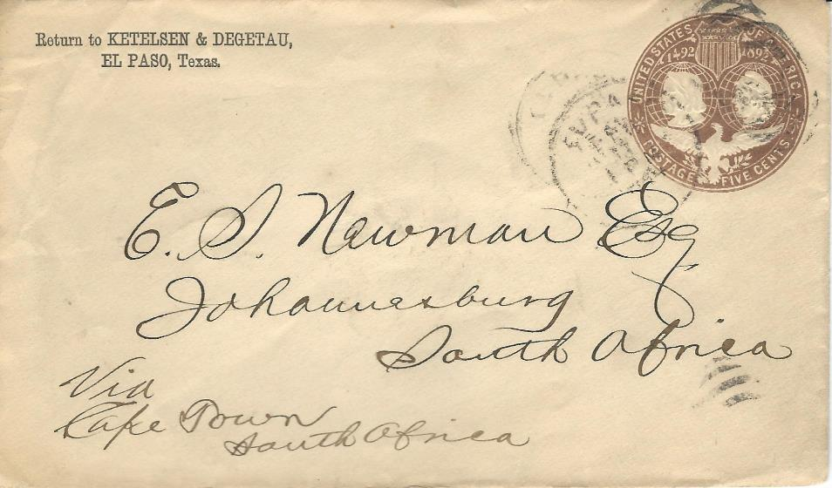
Questions?

Slide 69
Agenda
Registration of Delegates
Welcome and Report from the Chairman (Ian McMahon)
Election of the Bureau (Reinaldo Macedo)
Postal Stationery Qualifying Seminar
  Judging Postal Stationery (Mike Smith)
  Treatment (Sam Chiu)

Slide 70

Treatment in Postal Stationery
Judging
Presented at Macao, June 2026
On behalf of the Postal Stationery Commission
Sam Chiu Ph.D.
FRPSC, FRPSL, FIP Jury Fellow, AIEP
FIP – The Postal Stationery Commission https://postalstationery.f.i.p.ch/

Slide 71
Assumptions
Those in attendance are seasoned exhibitors and/or have national-level judging accreditations
Understand what the abbreviations GREV, SREV refer to
Explain where to locate these documents for further reference

Slide 72
Approach
“Back to the Basics”
Referencing the requirements for treatment as stated in GREV and SREV
What should juries be looking for in the evaluation of treatment in an exhibit?

Slide 73
GREV Criteria for Evaluation for Treatment
4.5 The criterion of "Treatment" requires an evaluation of the completeness and correctness of the selected material made by the exhibitor to illustrate his chosen subject.
Key words:
Completeness
Correctness

Slide 74
Observations
At this level of exhibiting, “Correctness” of material in exhibits is usually not an issue
However, occasionally exhibits are entered or transferred to the PS class largely comprised of material which is not treated as postal stationery, e.g. treated as postal history. These exhibits should not be judged as PS.

Slide 75

Treatment from SREV for PS
Key words:
Balanced
Logical Progression / Easy to Follow
Clear/concise write up
Introduction/plan represented in display
Helps jurors to appreciate the exhibit

Slide 76
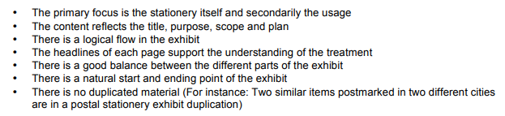
Continue from
3.1 Treatment from SREV for PS
These bullet-points highlight key statements, including the requirement to evaluate functional headings

Slide 77
Where and how should these requirements be met in an exhibit?
What should jurors be evaluating?

Slide 78
Areas of discussions
(brought up in SREV)
Title
Title Page requirements
  Purpose or Mission Statement
  Scope
  Plan
  Additional explanation of the “flow” of the exhibit
  Research Indication
  Reference(s)
  Rarity / Importance Indications
  Epilogue

Slide 79
Additional Areas
Balance
Clear / Concise write up
Additional Guideline for One Frame exhibits
Use of Synopsis
Page headings
selection of material and no duplication

Slide 80
Treatment
The most basic and over-riding requirement for an exhibit:
Logical Progression: That it be easy to follow
Mainly concerned with the clear and easy to follow STRUCTURE of the exhibit, as in part promised by the Title, Purpose, Scope and Plan AND by the Development (i.e. how the promises are kept along the pages of the exhibit)
Is in fact also the arrangement of the material on the pages, in a logical sequence, following the selection of the most suitable item for each page
Development (sequence of presented chapters and related material) should be in accordance with the plan and with an easy-to-follow storyline
Do the running headlines and other text support the understanding of treatment?
The exhibit should be cohesive (with no unrelated subjects) and coherent

Slide 81
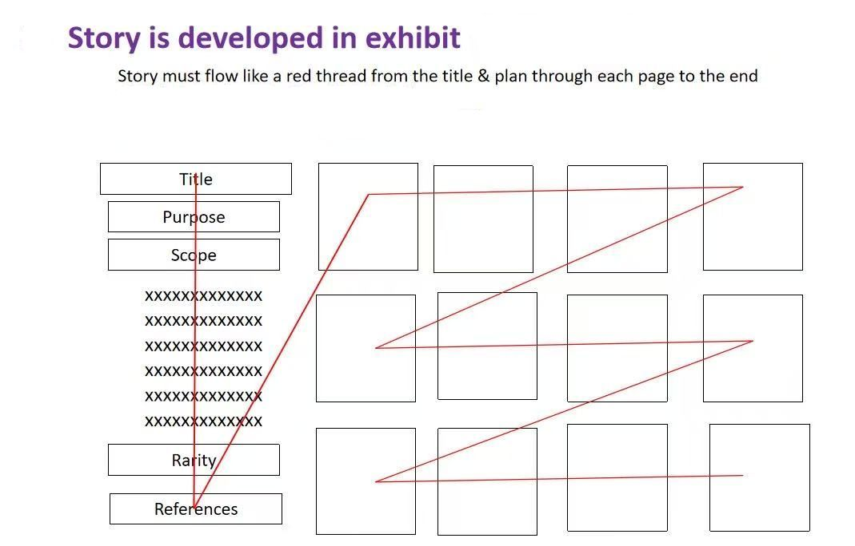
Slide provided by Stephanie Brosmer

Slide 82
Title of Exhibit
Should be brief and yet clear enough to state what a viewer will be seeing in exhibit
Should not try to be “cute” or try to show-off how smart the exhibitor is (and leave the viewer guessing what the exhibit is all about)
May include a time range (start – end)
May use a secondary statement to be even more specific
Is not usually an issue with PS exhibits

Slide 83
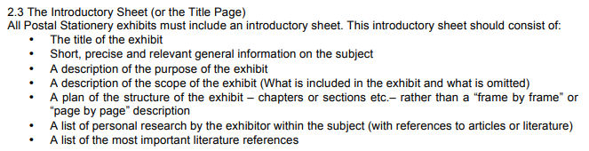
From SREV for PS on
Title Page / Introductory sheet

Slide 84
Title Page
SREV has made Title Page the most important page for the delivery of treatment information by the exhibitor. It is the key element jurors use to evaluate an exhibit
Should be a “road map” so viewers can follow the flow of the entire exhibit after reading this
It is a “must-have” document necessary for a complete exhibit application
The exhibitor can (and should) communicate effectively to the jurors/viewers using the valuable space on this page
Therefore, the space on this page must be used wisely

Slide 85
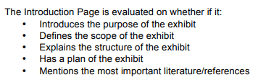
Title Page
SREV explains how important the title page is and has listed very clearly every item that is expected to be present. Each of these items will now be investigated.

Slide 86
Title Page
(Repeating these Requirements and the order of this presentation)
Purpose or Mission Statement
Scope
Plan
If needed, in addition to the plan, it explains how the exhibit flows
Reference(s)
(The above are specified in SREV)
(Additional considerations)
Epilogue
Rarity indication

Slide 87

Purpose or Mission Statement
Should be the first statement in the entire exhibit
Should be a comprehensive statement of what actually will be shown in exhibit as this is the first thing the viewer will read
Should not be the beginning of an historical background section with Purpose buried somewhere in the title page
This is foremost a philatelic exhibit and not a lecture on history. Background history should remain in the background. Mention of philatelic purpose is the paramount concern. Everything else is secondary

Slide 88

Scope
Defined by country, geographical region, reign, period, or campaign as well as date range should also be included in the title
SREV: What is included and what is omitted
Here the exhibitor should bring up whether any material is excluded in the exhibit (and why)
SREV: There is a natural start and ending point to the exhibit
Any additional explanation of the selected scope should also be addressed here
The viewer cannot be “ASSUMED” to know the reasoning behind the selected scope

Slide 89
What is PURPOSE and what is SCOPE ?
- What is included and what is omitted
PS Guidelines say this is the SCOPE
PH Guidelines say this is the PURPOSE
TR Guidelines say this is the PURPOSE
- Definition of Beginning and End and why those limits are chosen
PS Guidelines do not define PURPOSE
PH Guidelines say this is the SCOPE
TR Guidelines do not define the SCOPE
Slide supplied by
Peter Suhadolc
Confusing: We better get our act together!

Slide 90
Plan
SREV: rather than a “frame-by-frame” or “page-by-page” description
As an analogy to a book, these are chapter or section headings (exact words use in SREV)
Not a “laundry-list” (i.e. exhibitor should not attempt to list everything shown on every page. This is the wrong approach)
i.e. many exhibitors of 1-frame exhibits tend to list content of all 16 pages and label this a “Plan.” It is not!
If the subject matter is very complicated, use title page to list only chapters/sections. Sub-chapters/sub-sections can then be given at the beginning of each chapter/section.
Properly done this will address what SREV mentions the exhibit should aim for:
Logical Progression / Easy to Follow
In PS exhibits, exhibitors usually do not have any problem in this as most are usually listed in chronological order, then by issue and finally by issue dates

Slide 91
Additional explanation to the “flow” of exhibit
Usually not necessary for a PS exhibit with a good plan already presented
If subject is complex subject, additional explanation maybe necessary in addition to a plan
Consider how much verbiage is avoided by providing a good plan
SREV: Help jurors to appreciate the exhibit

Slide 92


Research Indication
This is NOT a treatment issue!
Arguably, it is a treatment issue, as exhibitor must use title page to show their research and personal study
SREV: Helps jurors to appreciate the exhibit
If there are few or no indications of research in this an exhibit, how can the jurors assign the 35 points?
This is, by far, is the most neglected area in exhibits, yet it is a requirement
SREV: A list of personal research by the exhibitor within the subject
Usual practice is to add symbols of a magnifier or an open book

Slide 93
Reference(s)
Only the “Most Important” Literature/Reference(s) should be listed on title page
Reference is NOT equal to Personal Research Indication
Common practice is to list as many references on title page as possible, but is this of any value?
Is this a good use of space for the title page?

Slide 94

Epilogue
SREV: There is a natural start and ending point to the exhibit
It also helps to provide and justify the ending point
Is not necessarily restricted to referencing the Scope
Back to the analogy of a book. A book telling a complete story should have a beginning, then the body of the story, and then an end
If the exhibit abruptly ends, is the exhibit “complete”?
How can one tell that the exhibit abruptly ends? When you look at the next frame and realise that it contains a different exhibit
Unfortunately, epilogues are only rarely seen in exhibits
Some use the analogy of 2 “book-ends”, i.e. the start as one and the epilogue as the other

Slide 95
It is easy to add an Epilogue
Use the next (following) PS or stamp issue to illustrate that the scope has ended
Example: for a Queen Victoria exhibit, end by showing a King Edward item
Just a statement as a conclusion is a weak epilogue
Philatelic item(s) should be included in an epilogue

Slide 96
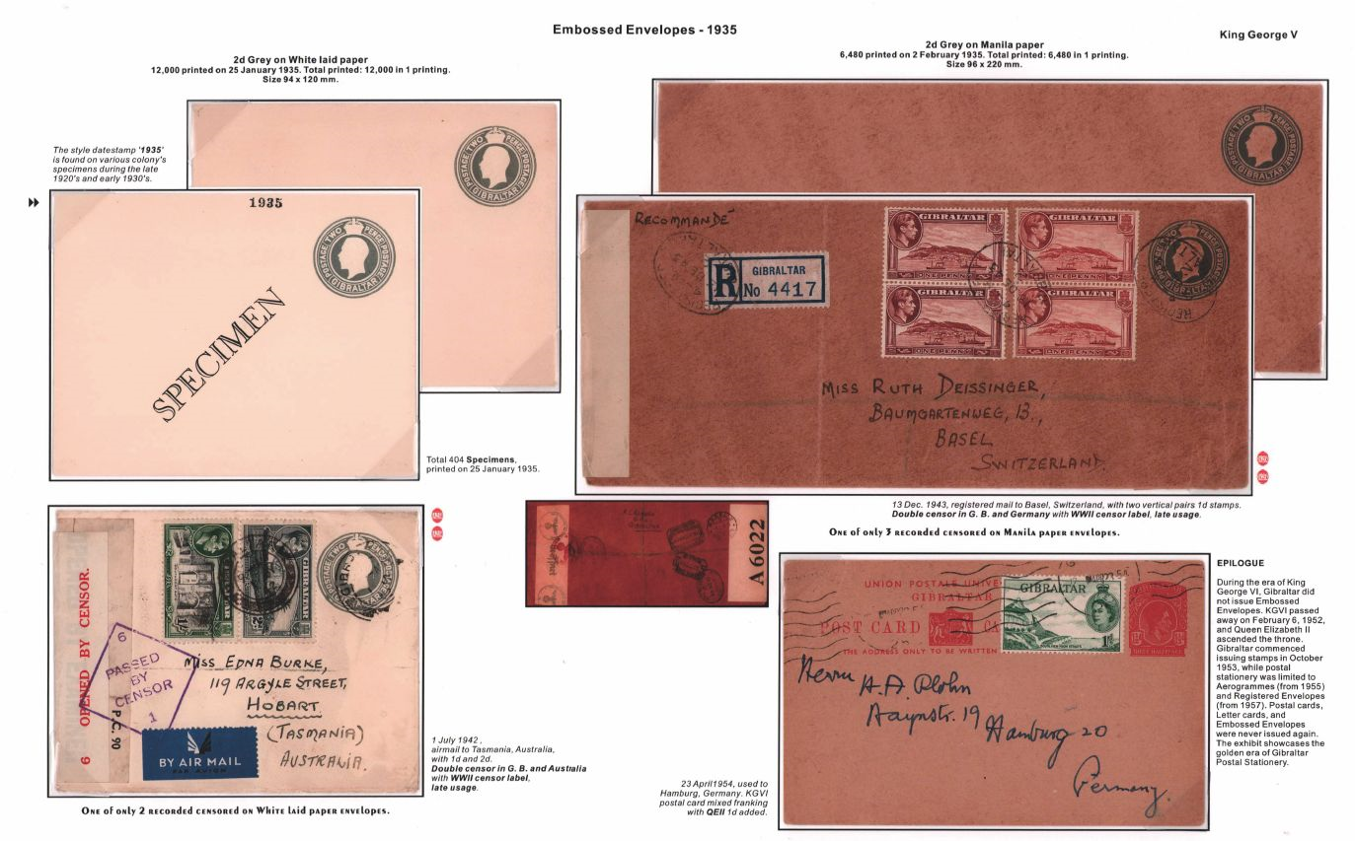
Example of an Epilogue
Exhibitor use an example used in the next monarch
But used an example form the previous monarch
Showed PS card were not issued by then, but show an example of usage
Brought out the point that he ended the exhibit, by showing the Golden Age of its PS history to justify end point
Epilogue page from Zhang Weiwei’s exhibit

Slide 97
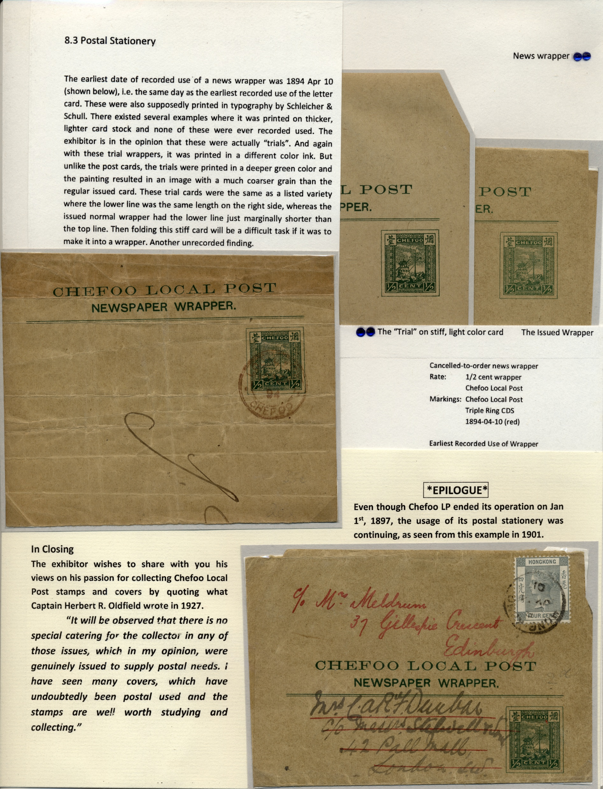
Question: What if the country became a dead country or the postal service ended? How do I show an Epilogue?
An example used as an Epilogue from the Chefoo Local Post exhibit
For a dead country, the “land” is still there; use a PS example from the new regime’s postal service
Chefoo Local Post was order to close at the start of 1897
Showed that a Local Post PS wrapper was still use as a wrapper in 1901, but not paying postage, but still of usage, even after the postal service has ended
A logical and good example for an Epilogue

Slide 98
Rarity (Important items) Indication
SREV: Help jurors to appreciate the exhibit
Common practice is to show a laundry list of important items. Is this a good practice and a good use of space on title page?
On the title page, an exhibitor should indicate the method used to get the viewers’ attention that an item is rare/important
More advanced exhibitors highlight rare/important items in their exhibit by using various techniques:
  Different color of frame, double lined frames, boxes
  Different color matting, i.e. red, dark blue, green, dark purple
  Color dots or color symbols or other symbols
  Additional statements supporting rarity/importance in different fonts and/or colors

Slide 99
Additional areas for considerations not related to Title Page

Slide 100
Balance
SREV: There is a good balance between different parts of the exhibit
Examining the Plan, jurors can know at first glance whether there is an issue with balance
This can be checked by what is actually displayed and the space that has been occupied
The exhibitor is usually the subject expert. Therefore, it is not easy to critique what has been displayed and label an exhibit unbalanced

Slide 101

Balance
A natural balance between the different postal stationery types
Bad balance:
  5½ frames envelopes
  1½ frame postal cards
  ½ frame letter cards
  ½ frame wrappers
  Or is it?

Slide 102

Balance
SREV: The primary focus is the stationery itself and secondarily its usage
Too often, PS exhibits “cross the line” and unnecessarily show too many examples of usages. This make the exhibit look more like a postal history exhibit rather than a postal stationery exhibit
How much is too much? Must be decided by the jurors
PH
PS

Slide 103
Write Up / Text / Description
Few realize that one way of describing text, does not necessarily fit all classes of exhibits, i.e. “One size does not fit all”
Presented here are Prof. Dr. Henrik Mouritsen’s excellent illustrations of a PS item that has been written up in 3 distinctively different ways to fit the class of exhibit shown
(presenter is grateful to Dr. Mouritsen for the use of these slides)

Slide 104
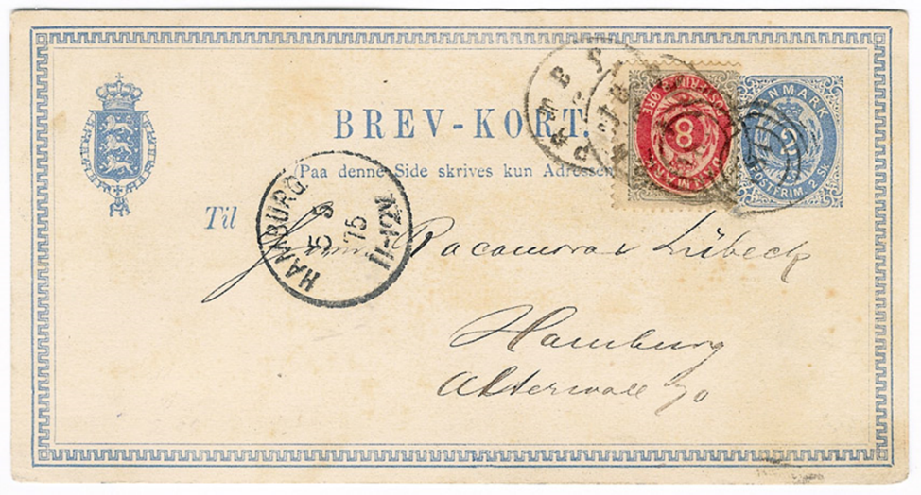
Postal Stationery text
2 sk stationery card print group I variety IV (small dent in inner frame to the left) used in the øre period as a 4 øre postcard and additionally franked with 8 øre print 2 and sent as pre-UPU postcard to Hamburg 05/May/1875.
Rate: Letters to Hamburg (no reduced rate for postcards existed) 12 øre 01/Jan/1875-30/Jun/1875.
ONLY RECORDED POSTCARD SENT TO A FOREIGN DESTINATION PRE-UPU IN THE ØRE PERIOD

Slide 105
Postal history text (in exhibit focusing on rates):
Pre-UPU postcard sent to Hamburg 05/May/1875. Reduced rates for postcards did not exist pre-UPU.
Therefore, all Danish pre-UPU postcards had to be rated as letters: 12 øre to Hamburg 01/Jan/1875-30/Jun/1875.
Mixed skilling-øre franking: 8 øre print 2 on 2 skilling stationery postcard.
ONLY RECORDED PRE-UPU POSTCARD SENT IN THE ØRE PERIOD

Slide 106
Traditional text
8 øre print 2 position B68 as part of a mixed skilling-øre franking on a 2 skilling stationery postcard (print group I, variety IV) sent as a pre-UPU postcard to Hamburg 05/Maj/1875.
Rate: Letters to Hamburg (no reduced rate for postcards existed) 12 øre 01/Jan/1875-30/Jun/1875.
ONLY RECORDED PRE-UPU POSTCARD SENT IN THE ØRE PERIOD

Slide 107
Write Up (continued)
SREV: a clear/concise write up
How can text be presented concisely?
A personal suggestion only: use point form
For many exhibitors, English (or the other FIP official languages) is not necessarily their native language
Point form can, in much fewer words, express what is most important
The demand for the correctness of grammar is lowered
This is a shorter and more efficient way of expressing the same amount of information than in a sentence
SREV explains that write up has to be “concise” but it does not say that it has to be in complete sentences
Questions for your consideration?
Are we to judge grammar in Write-up?
And for all other FIP approved languages……..

Slide 108
Additional Guideline for One Frame exhibit
Adopted on August 9, 2022 in Indonesia
“A One Frame Exhibit is intended to be an exhibit with a narrow subject that FITS in One Frame”
Key Word: FIT
UPDATE: Now FIP called this One Frame “Narrow Theme”

Slide 109
Use of Synopsis
A “must-have” requirement for exhibiting in North America is the submission of a synopsis (no more than two pages) at the time of application for a national level show
Why is this necessary?
SREV: Help the jurors to appreciate the exhibit
FIP shows allow exhibitor to submit a synopsis
For those who choose not to include a synopsis, the analogy is like boxing with one hand tied behind your back
Effectively allows the inclusion of much more information than can fit onto title page or is not appropriate on a title page. Allows for better communication to the jurors

Slide 110
Page headings
SREV: The headlines of each page support the understanding of the treatment
Page headings show viewer exactly what is shown on each page. Many exhibits lack page headings.
The page following should be in natural sequence to the preceding page
SREV: There is a logical flow in the exhibit

Slide 111
Selection of material and no duplication
SREV: There is no duplicated material ( For instance: two similar items postmarked in two different cities are in a postal stationery a duplication)
Example to follow

Slide 112
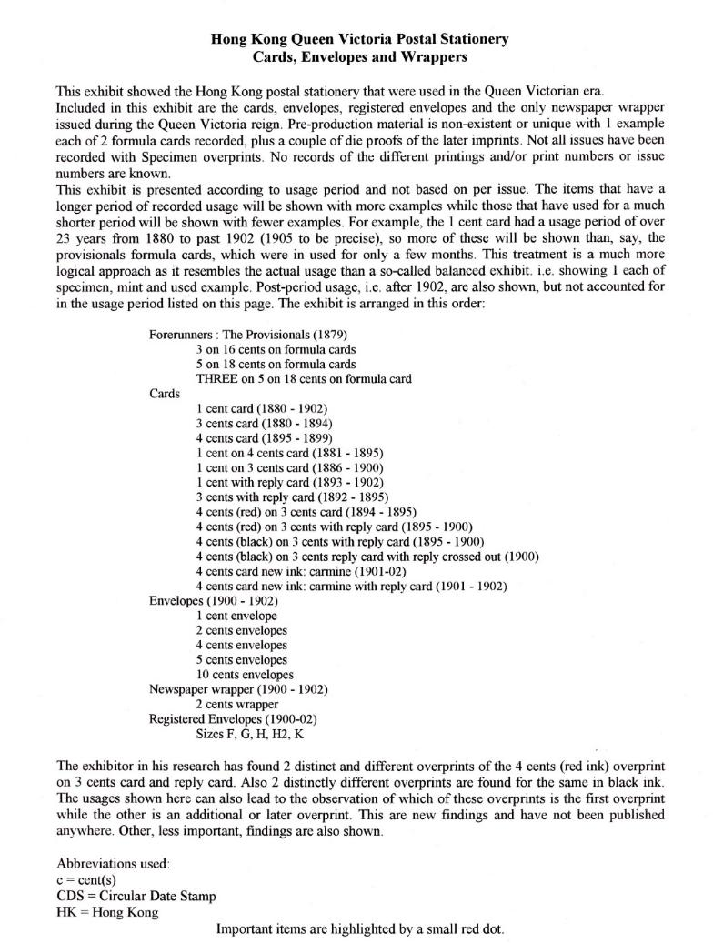
Year Scope missing in title
Purpose
Additional on Treatment
Plan
Epilogue missing
Research
Rarity indication
Reference missing

Slide 113
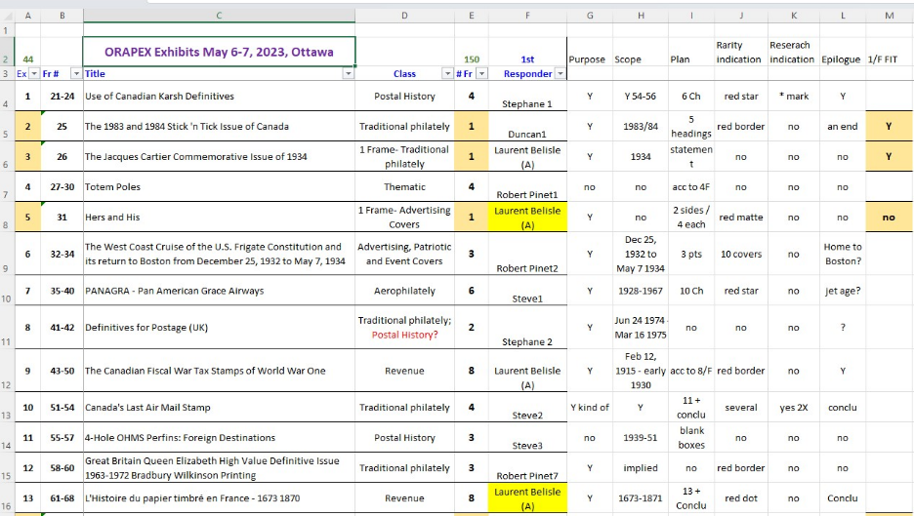
Preparation to judge a show:
Example of my prejudging notes for a recent national level show
As this was a national level show, references were not required on the title page

Slide 114
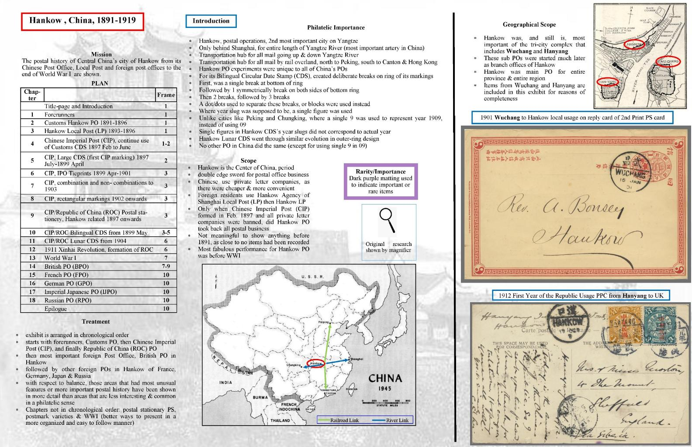
Scope: Geographical
Purpose
Plan
Scope: Time
Rarity indication
Research
Additional on Treatment
Reference missing

Slide 115
Examples of Title Pages from PS exhibition that has won LG in national level competitions

Slide 116
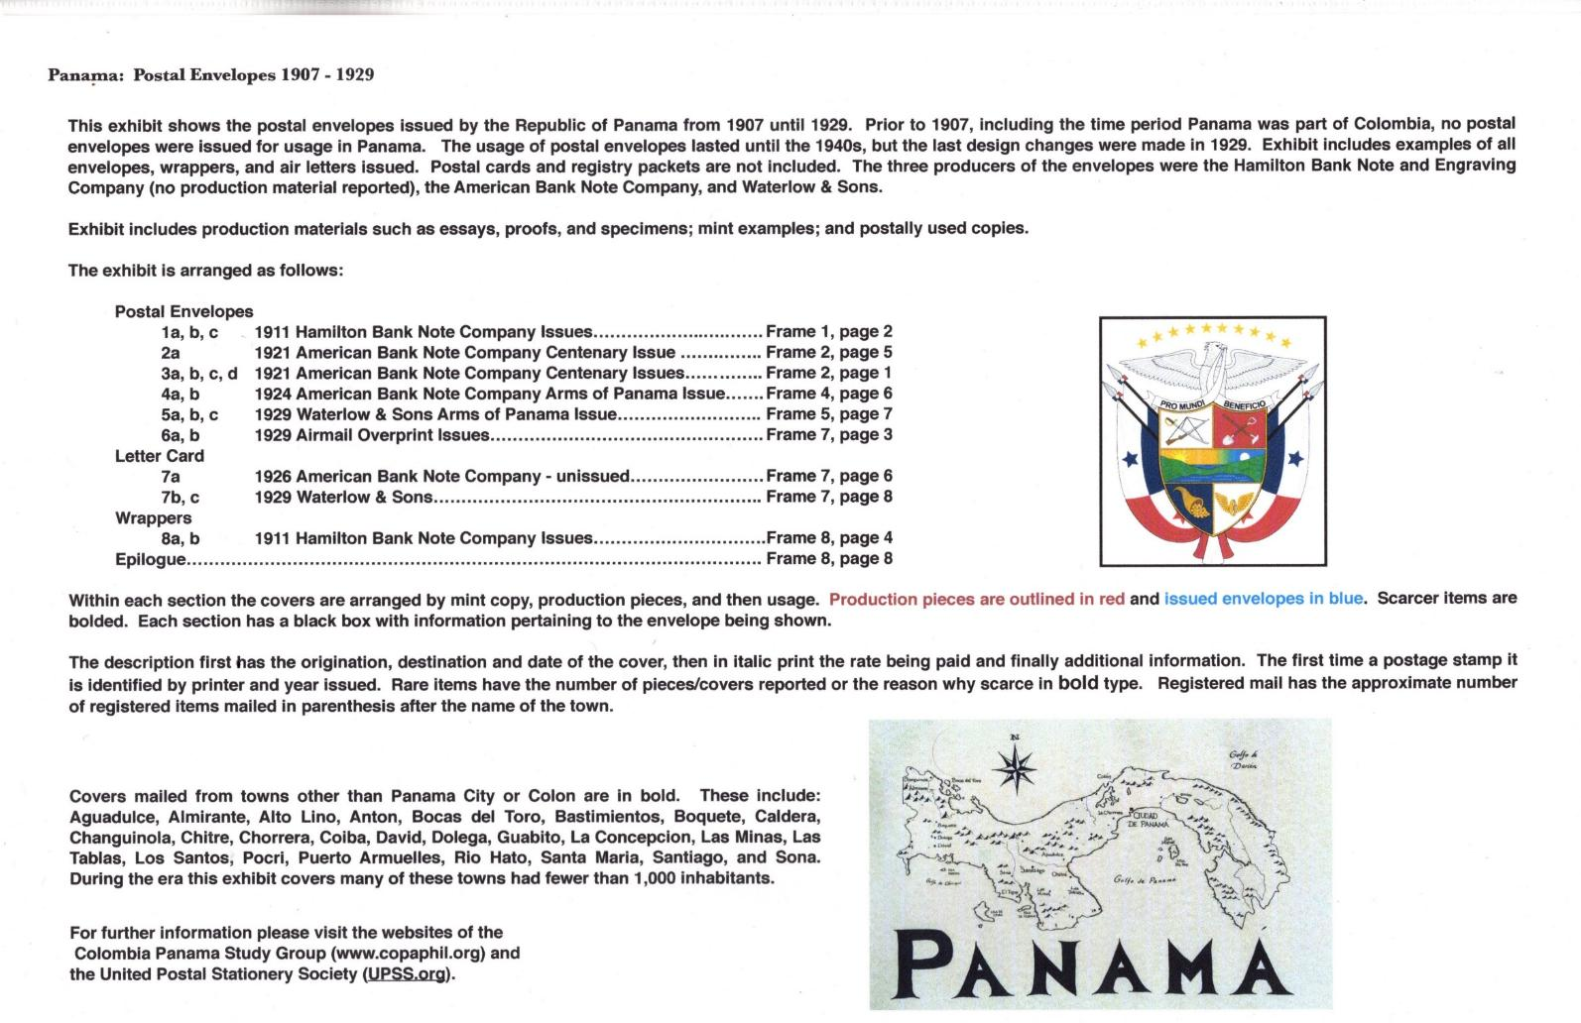
Purpose
Scope: Time, geographical
Plan
Epilogue
Research indication missing
Rarity indication
Reference

Slide 117
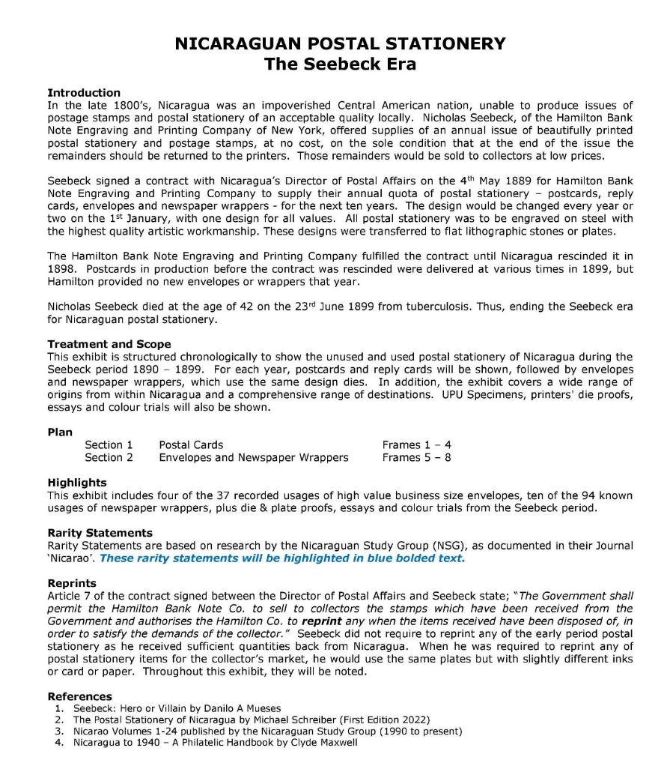
Purpose : stated in treatment
Treatment
Scope: Geographical & Time
Epilogue missing on TP, but was present in exhibit
Plan
Research indication missing
Rarity indication
References

Slide 118
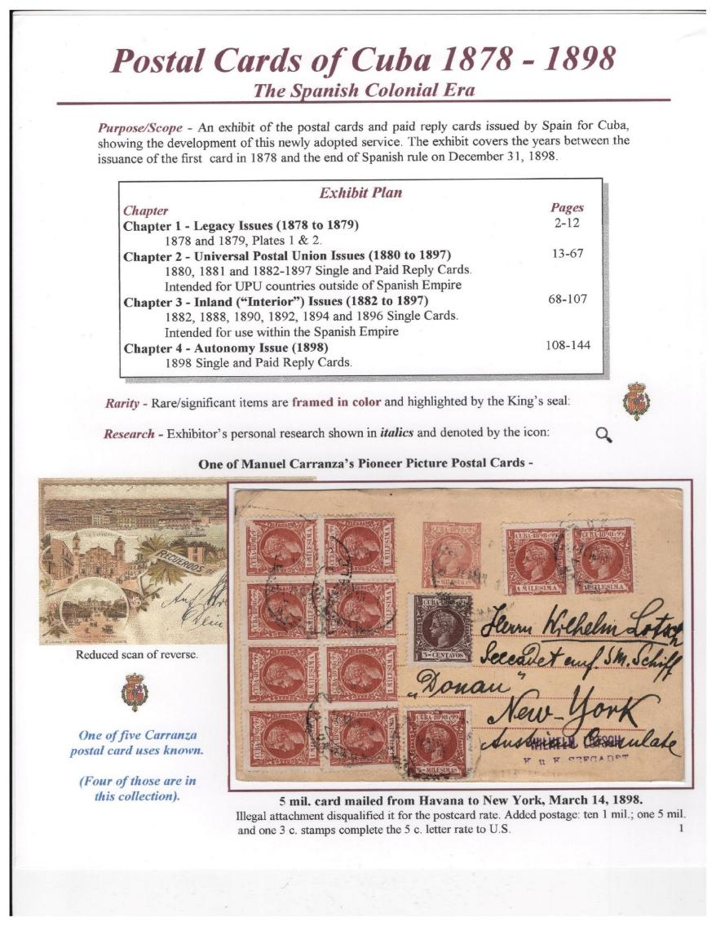
Purpose
Scope: Geographical & Time
Plan
Epilogue missing on TP, but was present in exhibit
Rarity indication
Research indication

Slide 119
Now A Test!
Question: Should the following exhibit be judged as a Postal Stationery Class Exhibit (showing an exhibit page and the title page)?

Slide 120
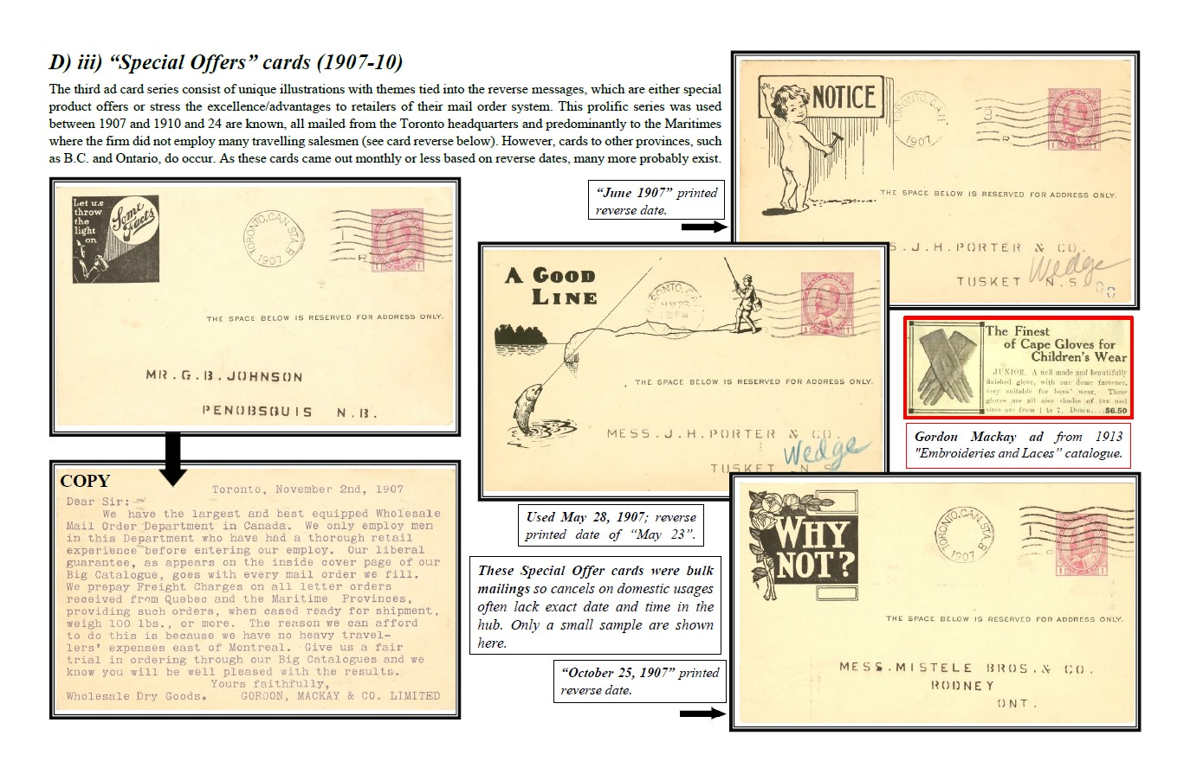

Slide 121
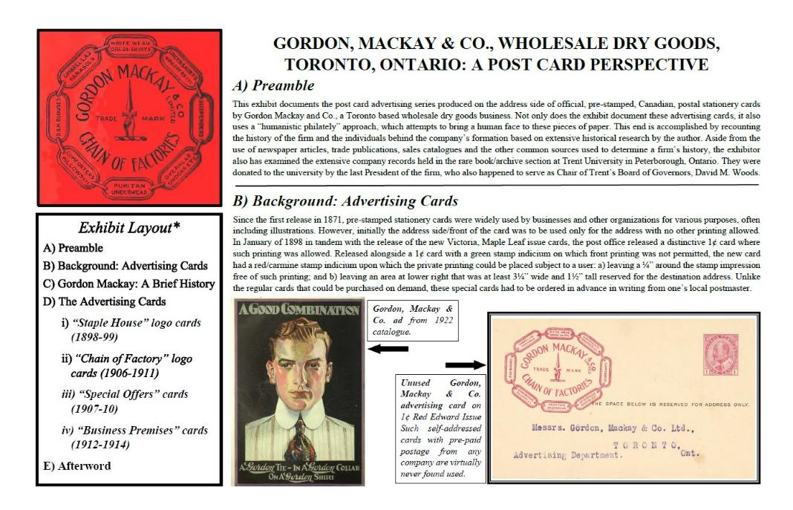
Answer: No
Exhibit is about private printing on PS cards & should not be judged as a PS class exhibit

Slide 122
SREV: There is no duplicated material ( For instance: two similar items postmarked in two different cities are in a postal stationery a duplication)
Question: Is this pair a duplication?

Slide 123
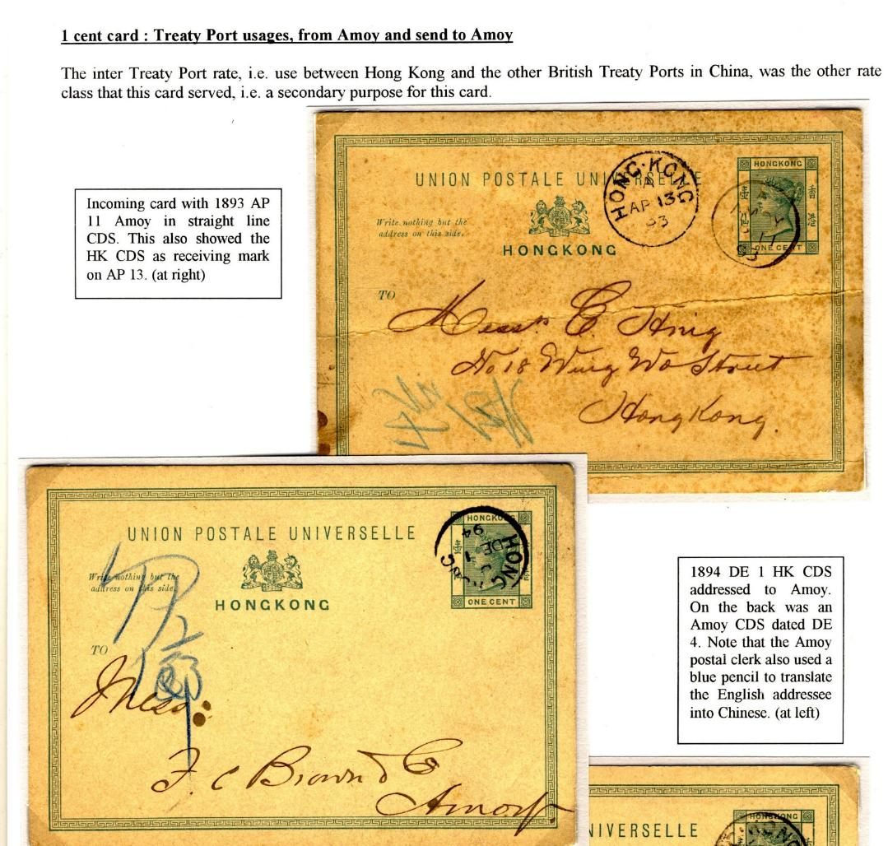

Slide 124
Amoy (a Treaty Port in China, also allowed to use HK PS cards) to HK.
This shows a different usage where the PS card were allowed to be usage from a Treaty Port in China
Answer: Not a Duplication
Hong Kong (where these PS were produced for) to Amoy.
This show a “regular” usage from HK to a Treaty Port in China.
Learnings:
Shows that before a juror criticizes, he/she must have specific and accurate knowledge about the subject.
Be careful!

Slide 125
Congratulations
Everyone have passed the test!

Slide 126
Acknowledgements
This presentation is a group effort with input from these philatelist:
Content Input: Peter Suhadolc, Dr. Ian McMahon, Mike Smith,
Slides/title pages slides supplied by: Dr. Ian McMahon, Mike Smith, Dr. Henrik Mouritsen, Chris Ellis, Zhang Weiwei, Glen Stafford, Bradley Wilde, Octavio Cabrera, Stephanie Bromser
Editing: Dr. Robert Pinet

Slide 127
Thank You

Slide 128
Questions, Answers & Comments please

