Slide 1
Welcome to the Commission Meeting 2022
The Postal Stationery Commission

Slide 2
Today’s Agenda
Registration of Delegates
Report from the Postal Stationery Commission Bureau – Ian McMahon
Postal Stationery: The Good, The Bad and The Ugly - Glen Stafford
Election of the Bureau - Reinaldo Macedo

Slide 3
Report from the Postal Stationery Commission Bureau
The Postal Stationery Commission

Slide 4
POSTAL STATIONERY EXHIBITING 2018-2020
July 2018 - January 2020: The Bureau sees postal stationery collecting and exhibiting as vibrant as ever before. We are seeing an increasing number of postal stationery exhibits: 22 postal stationery exhibits were entered at Thailand 2018 and 30 at China 2019.
March 2022: Pandemic resulted in the cancellation or postponement of exhibitions.
Exhibitors have had few opportunities to exhibit internationally at face-to-face exhibitions.

Slide 5
POSTAL STATIONERY EXHIBITING 2020-21
Virtual Exhibitions
opportunities for exhibitors and ability to view postal
stationery exhibits on-line.
Opportunity for judges to maintain their judging skills
Examples:
AusVipex 2020 November 2020 Australia
PHILAVIRTU October 2020 India
Canpex 2021 April 2021, Royal 2021 October 2021 Canada
Savpex 2021 August 2021, July 2022 South Africa
First FIAP virtual exhibition, BANGABANDHU 2021 Dec 21

Slide 6
VIRTUAL JUDGING
consensus approach to judging can be achieved
Zoom team meetings and Zoom Jury meetings enabled consensus approach with Zoom enabling exhibits to be ‘shared’ during the meetings and considered by the team or the whole Jury
Zoom a useful tool for judging and for providing feedback to exhibitors while acknowledging that some exhibitors may not have had the necessary equipment to participate in feedback sessions.

Slide 7
POSTAL STATIONERY EXHIBITING 2022
Some challenges and restrictions still remain but FIP exhibitions in 2022:
London 2022
HUNFILEX 2022 (no postal stationery class)
Helvetia 2022
Indonesia 2022
Cape Town 2022 (November)

Slide 8
Commission Projects 2016-2020
Project 1: Newsletters We will continue to issue our commission newsletter with information on exhibition results, articles on exhibiting etc. The Newsletter will be issued twice a year
Project 2: Videos on YouTube We will make one or more videos of seminars or other information about postal stationery exhibiting and publish it in YouTube
Project 3: Commission Facebook page We will make a Facebook page for the commission and open up for dialogue between exhibitors, jurors and the commission
Project 4: Commission Website Update The commission website needs an update with a new lay-out. The content will be converted to the new website, while the overview and navigation will become easier.
Project 5: Seminars & New Presentations We will develop a new version of the general presentation on judging postal stationery. We will also develop new supplementary presentations about special areas within exhibiting and judging postal stationery

Slide 9
Commission Newsletter
We continue to send out two newsletters every year (January and August) – each of 24-32 pages
Delegates: Please send details of PS activities in your country at least once a year
We would like to have one substantial article with research findings on PS in every newsletter. Please send in articles!

Slide 10
Postal Stationery Videos
no formal Commission videos
wide range of on-line postal stationery seminars from postal stationery and other societies; invitations sent to the on-line presentations hosted by the Postal Stationery Society of Australia.
Societies with active programmes of postal stationery presentations include the United Postal Stationery Society (USA), the Postal Stationery Society of Australia and Mi Oficina Philatelic Society.
presentations on exhibiting, for example, those held by PHILAVIRTU postal stationery exhibiting see https://www.youtube.com/watch?v=Yv7UWI7S0K8 and an on-line presentation on exhibiting postal stationery by Lars Engelbrecht on 27 April 2020 as part of the Philaminars 2020 on-line series.

Slide 11
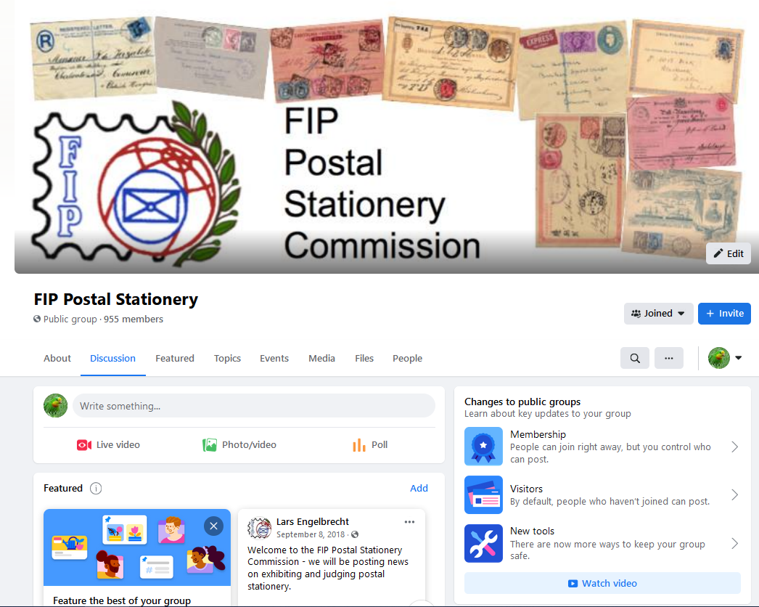

Slide 12
Commission Facebook Page
Facebook page for the FIP Postal Stationery Commission continues to operate
Updated with news on exhibiting and judging postal stationery
Please use the page to share photos, comments and ask questions
Please join the page – search on Facebook for: ”FIP Postal Stationery”

Slide 13
Commission Webpage
Commission website now hosted by FIP
https://postalstationery.f-i-p.ch/
Change over done by Ross Towle
Updated with news on exhibiting and judging postal stationery
Please use the page

Slide 14
COMMISSION MEETINGS AND SEMINARS
Pre-Pandemic
Last formal Commission meeting at Thailand 2018
Lars Engelbrecht and Ian McMahon seminar How To Develop Your Postal Stationery Exhibit at Thailand 2018.
Postal Stationery (FIP Qualifying Seminar) Exhibiting and Judging Postal Stationery China 2019 (Ian McMahon)
Mike Smith, Ian McMahon and Steve Schumann presented a seminar on Current Trends in Postal Stationery Exhibiting Stockholmia 2019.
2022
London 2022 Qualifying Seminar (Ian McMahon)

Slide 15
The Present
Indonesia 2022 election of the Bureau of the Postal Stationery Commission
New Bureau will redefine projects
Postal Stationery exhibits & exhibitions
Likely need for revision of the guidelines

Slide 16
Postal Stationery Exhibits
PS exhibits in international exhibitions
London 2022 38 Exhibits 5 Large Gold 11 Gold
Helvetia 2022 30 PS exhibits, 2 Large Gold, 9 Gold
Introduction pages are improving
Many really good new exhibits!

Slide 17
Exhibitions with a Postal Stationery Class
8 - 12 November 2022 | South Africa | Cape Town 2021 | FIP
13th – 16th, October 2022 | Liberec | Liberec 2022 | FEPA
25 - 28 May 2023 | Germany | IBRA 2023 | FIP
4 - 7 May 2023 | New Zealand | NZ2023 | FIAP
11 -15 August 2023 | Chinese Taipei | Taipei 2023 | FIAP
TBC 2023 | Thailand | Thailand 2023 | FIP
March/April 2024 | Australia, Melbourne | Melbourne 2024 | FIAP
23-30 May 2026 | USA Boston | Boston 2026 | FIP

Slide 18
Update of FIP Guidelines
Purpose: Alignment the guidelines of ALL classes, so the description of the judging criteria is the same in all classes
Most commissions have updated their guidelines – and used the 2012 version of the postal stationery guidelines as model

Slide 19
Update of FIP Guidelines
Still concerns about some of the definitions of Postal Stationery eg Study by FIAF Postal Stationery Commisison
The Postal Stationery commission will review the new guidelines and suggest a minor update in 2023

Slide 20
Questions?

Slide 21
Today’s Agenda
Registration of Delegates
Report from the Postal Stationery Commission Bureau
Postal Stationery: The Good, The Bad and The Ugly - Glen Stafford
Election of the Bureau

Slide 22
Postal Stationery The Good, The Bad and The Ugly
The Postal Stationery Commission
Version 1.0 2022
By: Glen Stafford

Slide 23
The Postal Stationery Commission
Who is Glen Stafford?
International Judge FIP & FIAP
National Judge APF
FIAP Executive Member
APF International Officer (Past President)
RPSL & RPSV Member
Active collector since 17 years old
42 years in Medical Imaging
Version 1.0 2022
By: Glen Stafford

Slide 24
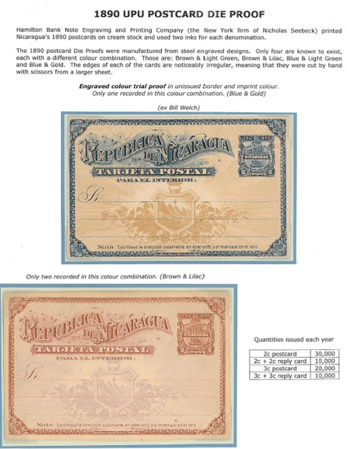
The Good – Gold (90pts)
Nicaraguan Postal Stationery
– Seebeck Period

Slide 25
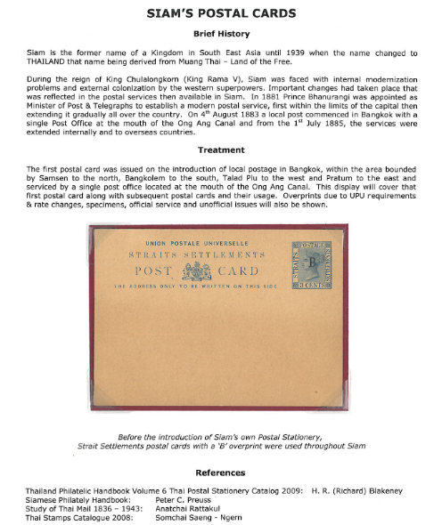
The Bad – Vermeil (83 pts)
Siam Postal Cards

Slide 26
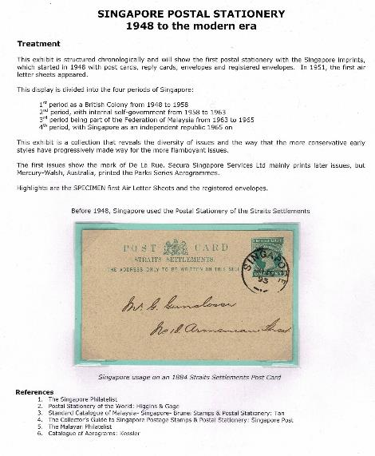
The Ugly – Silver Bronze (69pts)
Singapore PS

Slide 27
The Definition of Postal Stationery
“Postal Stationery comprises postal matter which either bears an officially authorized pre-printed stamp or device or inscription indicating that a specific face value of postage or related service has been prepaid”
Defined by FIP Postal Stationery Commission in the regulations for judging postal stationery exhibits

Slide 28
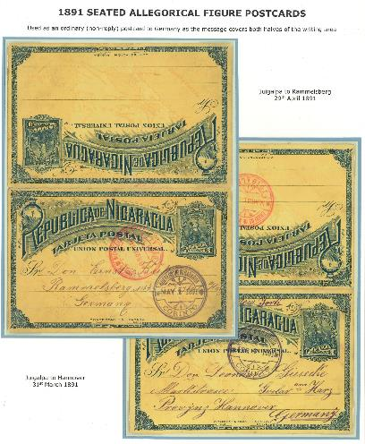
The Good

Slide 29
The Good

Slide 30
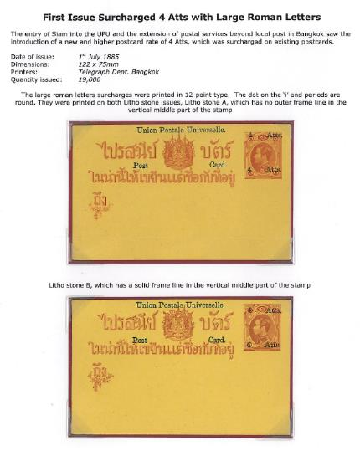
The Bad

Slide 31
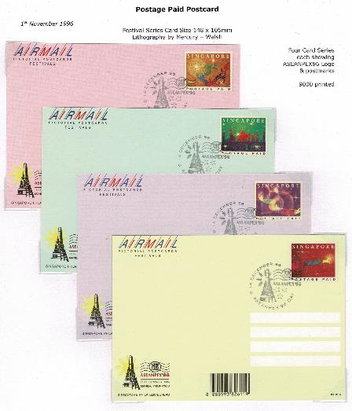
The Ugly

Slide 32
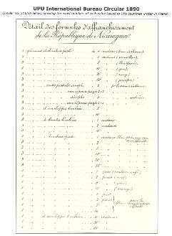
Essays, Proofs and Specimens
Archival material: Essays, proofs and specimens can be included in postal stationery exhibits
Also relevant postal documents can be shown

Slide 33
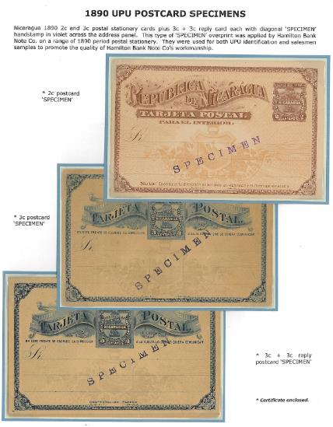
Specimens
Do not get too impressed by exhibits with lots of specimens (especially from the British Colonies). Often items with ”Specimen” overprints exist in larger numbers than the same used items.

Slide 34
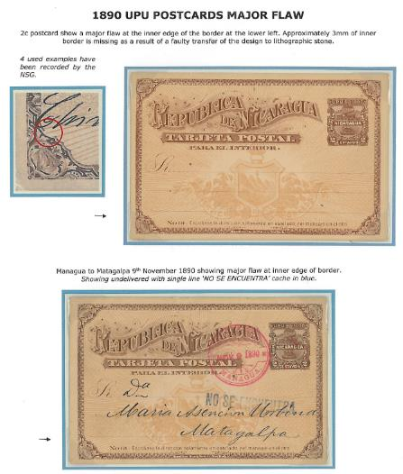
Used and/or Unused?
Is it ok to mix used and unused material in an exhibit?
Yes!

Slide 35
Defining the Exhibit Purpose
The exhibit purpose identifies the reason for showing this exhibit:
“This exhibit shows the varieties and use of Siam Postal Cards – 1885 -1939"
A postal stationery exhibit should have a clear purpose often defining it by: Country, Period and/or Issue together with Physical Form, Availability, Function etc.

Slide 36
Defining the Exhibit Scope
The exhibit scope sets the boundaries for the exhibit:
"The exhibit shows the Nicaraguan Postal Cards, Envelopes and Wrappers from Hamilton Banknote Co. From the first issue in 1890 until the last issue in 1899
– Known as the Seebeck Era"

Slide 37
Purpose and Scope "Traditional" vs. "Postal Historic" Postal Stationery Exhibits
Postal Stationery exhibits should primarily be focusing on the stationery itself (traditional treatment)
Secondly usages and additional franking should be described (postal historic treatment)
A lot of postal stationery exhibits only focusing on the use: "The use of Canadian postal cards" without any description of the postal stationery itself. This will have a negative impact on the evaluation of the treatment of the exhibit

Slide 38
The Judging Criteria
Treatment (20) and philatelic importance (10) 30 points
Philatelic and related knowledge, personal study and research 35 points
Condition (10) and rarity (20) 30 points
Presentation: 5 points

Slide 39
Treatment (20 points)
Title page has clear purpose, scope and plan
The content reflects the title, purpose, scope and plan
A logical flow in the exhibit
The headlines of each page support the understanding of the treatment
No duplicated material
Good balance between the different parts of the exhibit
Natural start and ending point of the exhibit
Treatment of primarily the postal stationery - secondly the use, rates and additional franking

Slide 40
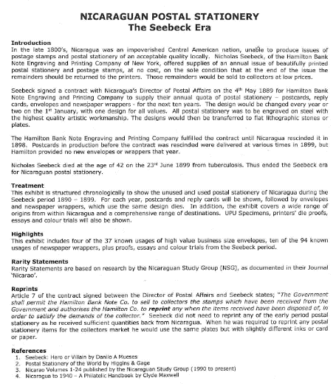
Treatment - The Good The Introduction Page
A clear headline: The title
The purpose and scope of the exhibit
The structure of the exhibit
A plan of the exhibit
Literature used
Highlights
Rarity Statement

Slide 41
Treatment - Bad The Introduction Page
A clear headline: The title
No purpose and or scope of the exhibit
The structure of the exhibit – not clear
A plan - Nil
Literature used
Highlights - Nil
Rarity Statement - Nil

Slide 42
Treatment - Ugly The Introduction Page
A clear headline: The title
No purpose and or scope of the exhibit
The structure of the exhibit – not clear
A plan - Minimal
Literature used
Highlights - Nil
Rarity Statement - Nil

Slide 43
Treatment – The Good Description of the Items in the Exhibit
As mentioned earlier a postal stationery exhibit should be treated with focus primarily on the postal stationery itself and secondly with the postal historic aspects
Example:
Good item description:
"5 Centimos Dark Green, Variety 6. 12000 printed. Additional franking for domestic use"
Bad item description:
"25 March 1877. Sent from Nice to Venice. Postmark on reverse"

Slide 44
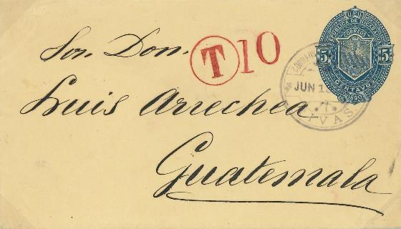
Treatment – The Good Description of the Items in the Exhibit
As mentioned earlier a postal stationery exhibit should be treated with focus primarily on the postal stationery itself and secondly with the postal historic aspects
"5 Centavos Blue Indicia 158 x 90 mm -25000 printed. For domestic use - tax Stamp for foreign destination"

Slide 45
Treatment – The Bad Description of the Items in the Exhibit

Slide 46
Treatment – The Ugly Description of the Items in the Exhibit

Slide 47
Philatelic Importance (10 points)
How difficult is the selected area?
What is the significance of the selected area compared to the national philately of the country?
What is the significance of the selected area compated to world philately?
What is the significance of the shown material compared to the selected area?

Slide 48
Knowledge, Personal Study and Research (35 points)
Correct description of the postal stationery type
Use of literature within the area
Earliest recorded use & numbers printed
Watermarks, perforations, paper etc described
Description of printings and varieties
Research (lack of research in areas previously well-described is ok)
The choice of items reflects knowledge
Correct descriptions of rates and usage
The ”not-obvious” is described

Slide 49
Condition (10 points)
The postal stationery is in the best possible quality
Ordinary material without defects
”Difficult” items in the best possible quality
Clear postmarks
Evaluate the condition of the items as if they were stamps:
No tears, No missing corners, No bends, No stains, No missing perforation

Slide 50
Rarity (20 points)
Are the best items (postal stationery types) within the area in this exhibit?
Essays and proofs, approved and rejected
Used at intended rate and with additional franking (express, registered etc)
How difficult are the items to find?
How easy will it be to duplicate the exhibit?
Is there philatelic produced material in the exhibit?

Slide 51
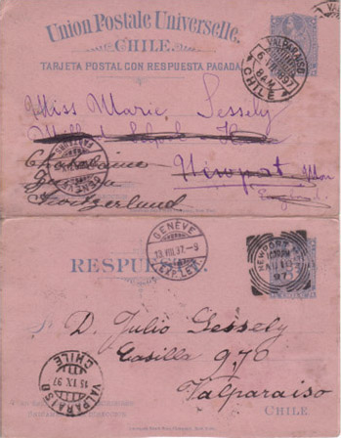
Rarity
Usually reply cards used both ways are generally scarce
In many cases especially both used locally and abroad

Slide 52
Presentation (5 points)
Good balance in the frames and the individual pages
Good use of the page
Sufficient write up
Not too much text
Illustrations not too dominating
Overall impression: Not sloppy
Variation in mounting is preferred

Slide 53
Variation in Mounting
It is easy to make variation in the mounting

Slide 54
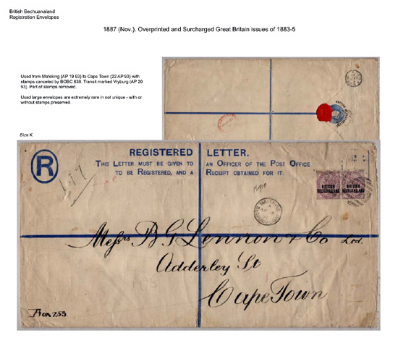
Mounting Large Items
Mounting large items can be a challenge
Especially registered covers and wrappers can be oversized
(Size K envelope)

Slide 55
Questions or Discussion? Thank you.

Slide 56
Today’s Agenda
Registration of Delegates
Report from the Postal Stationery Commission Bureau
Postal Stationery: The Good, The Bad and The Ugly - Glen Stafford
Election of the Bureau - Reinaldo Macedo

Slide 57
